Slide 1

REAL ESTATE SALES 2001-2020 GL
JOLA ADEJUMO

Slide 2
BACKGROUND
The Connecticut Office of Policy and Management maintains a listing of all real estate sales with sales price of $2,000 or greater, that occur between October 1 and September 30 of each year.
For each sale record, the file includes town, property address, date of sale, property type (residential, apartment, commercial, industrial, or vacant land), sales price, and property assessment.
This project is a comprehensive data analysis of all property assessment and sales records between 2001 and 2020. The goal is to empower stakeholders in the real estate sector with actionable insights for better decision-making and improved accuracy in property assessments.

Slide 3

OBJECTIVES
Uncover insights into the accuracy of property assessments, identifying areas where adjustments may be necessary.
Gain a nuanced understanding of market trends, allowing stakeholders to make informed decisions based on current and historical data.
Provide localized insights for different towns, assisting in regional planning and investment decisions.
Understand the impact of property type on assessment outcomes, helping to tailor strategies for different segments of the real estate market.
Investigate the role of non-use codes in property assessment, identifying patterns and potential areas for policy refinement.
Utilize Assessor and OPM remarks to improve communication and transparency in the assessment process.

Slide 4
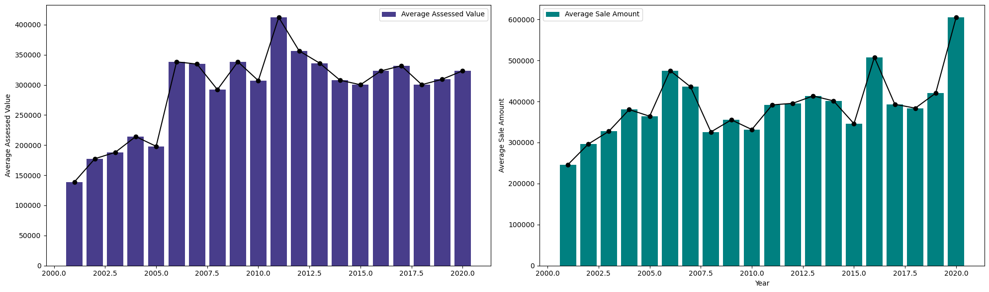
ACCURACY OF PROPERTY ASSESSMENTS
Sale Amount were typically higher than the Assessed Value, showing discrepancies between the two.
The highest property sale was in the year 2020.

Slide 5
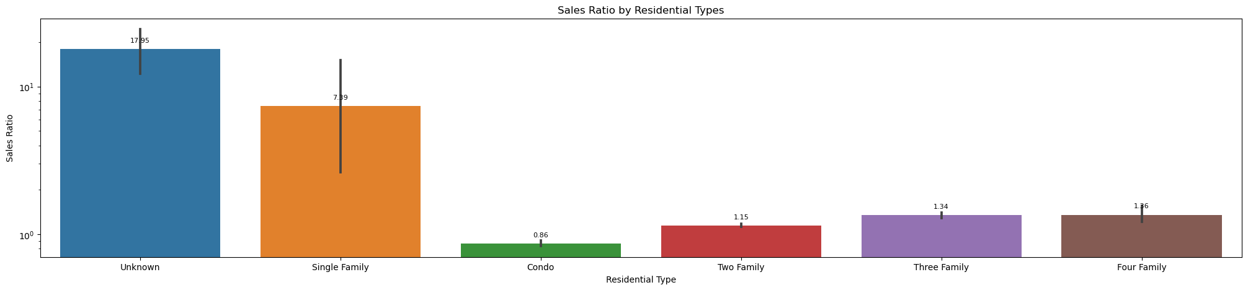
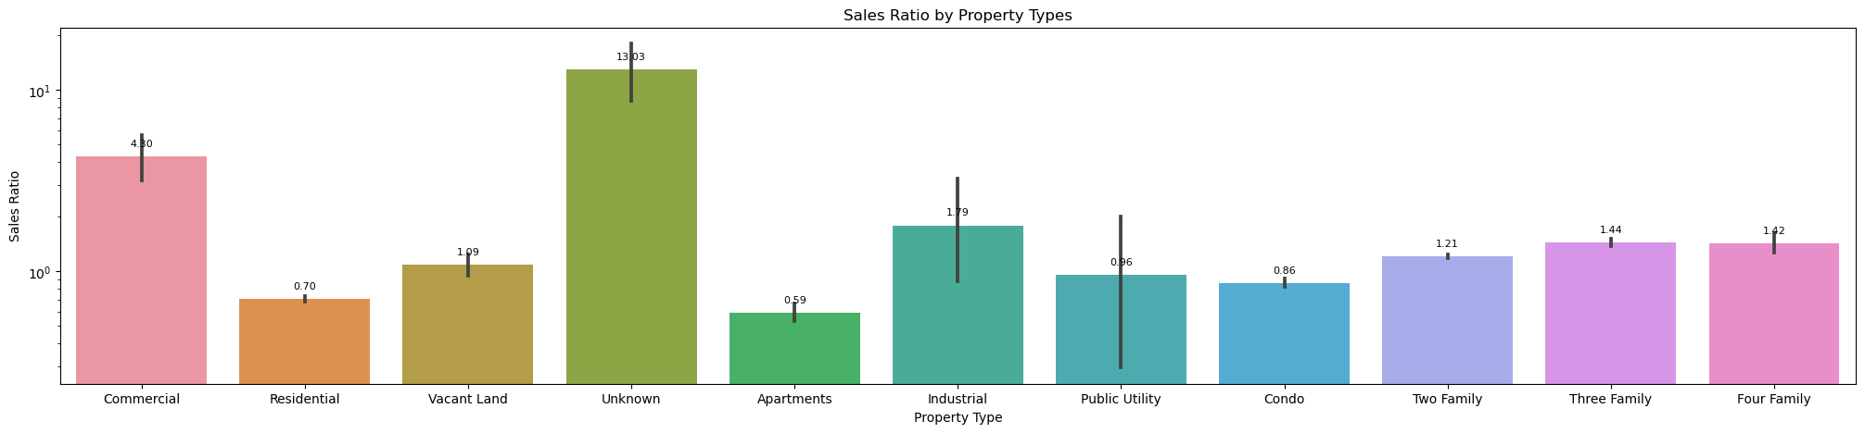
MARKET TRENDS
A lot of the residence types were unspecified - this accounted for the highest sales ratio, followed by the single-family residential type.
This was the same for property types, with the commercial and industrial property types accounting for the highest sales ratio behind the unknowns.

Slide 6
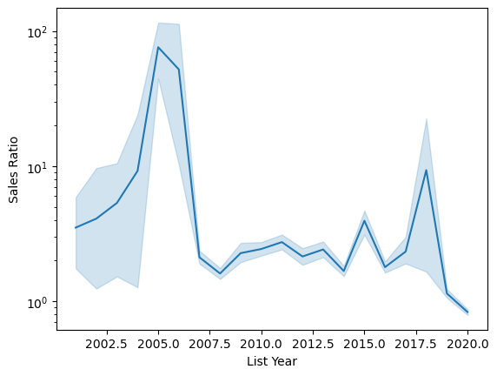
MARKET TRENDS
Sales Ratio vs List Year
Sales Ratio was the highest between 2005 -2006, with spikes in 2015 and 2017.

Slide 7
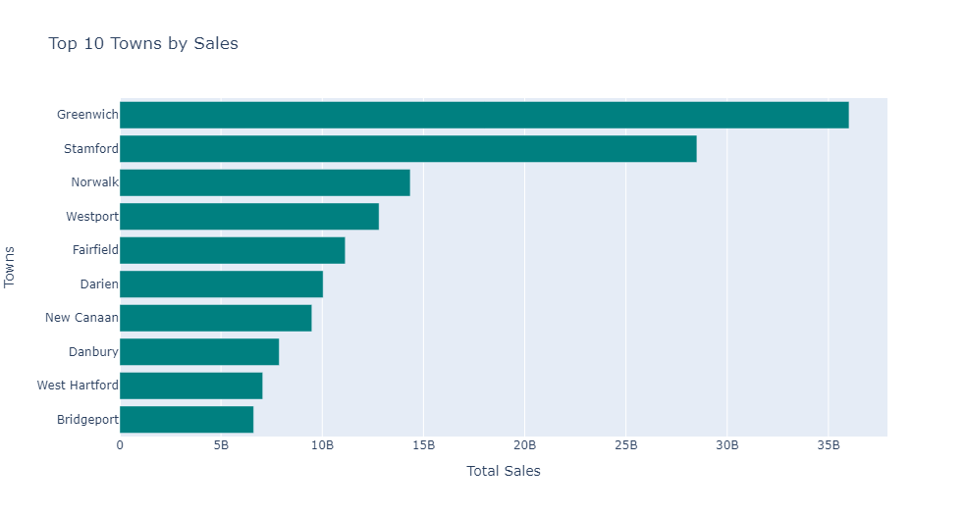
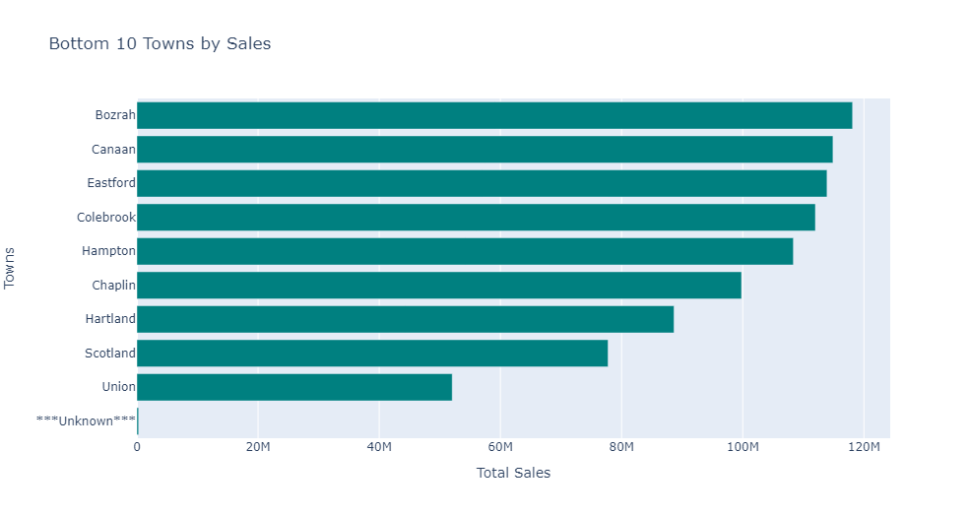
LOCALIZED INSIGHTS
The highest selling towns were Greenwich , Stamford, and Norwalk
The least selling towns were Union, Scotland, and Hartland.
Unknown was the least, accounting for a total sales of $282.45k.

Slide 8
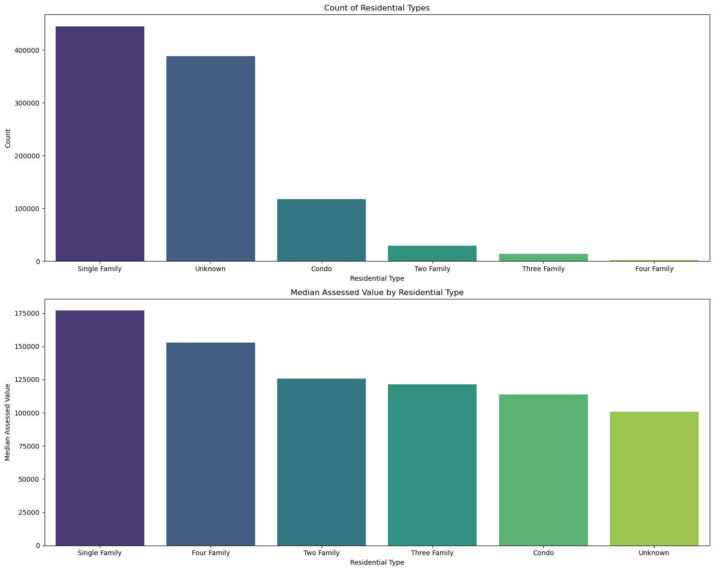
PROPERTY TYPE IMPACT
Single family homes were the most expensive, followed by the four-family and the two-family.

Slide 9
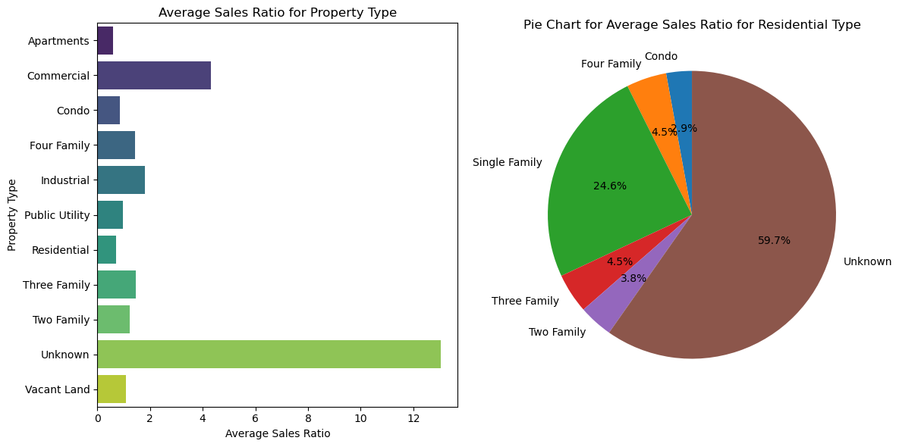
PROPERTY TYPE IMPACT
Average Sales Ratio across Property Type and Residential Type

Slide 10
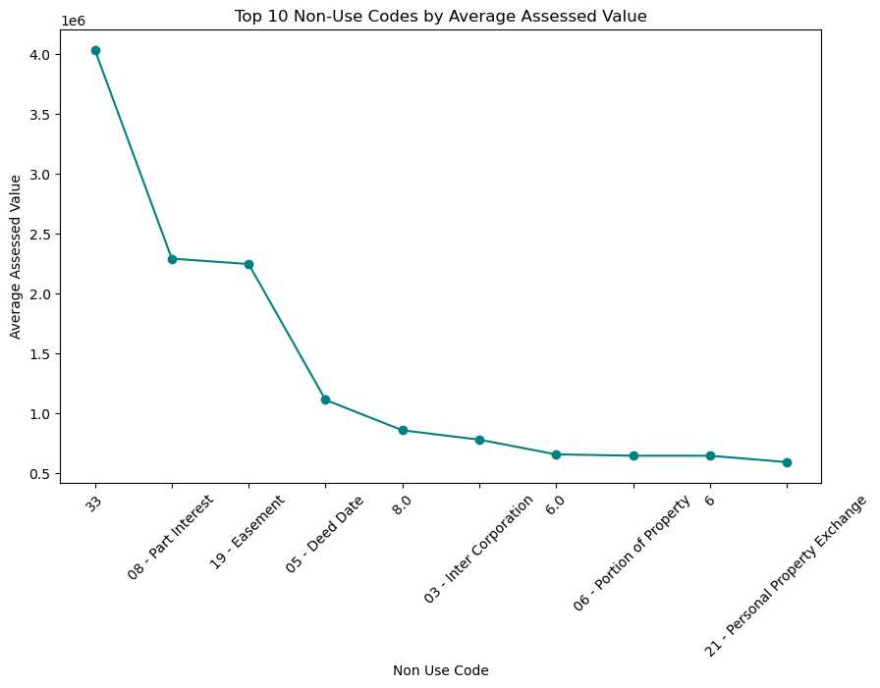
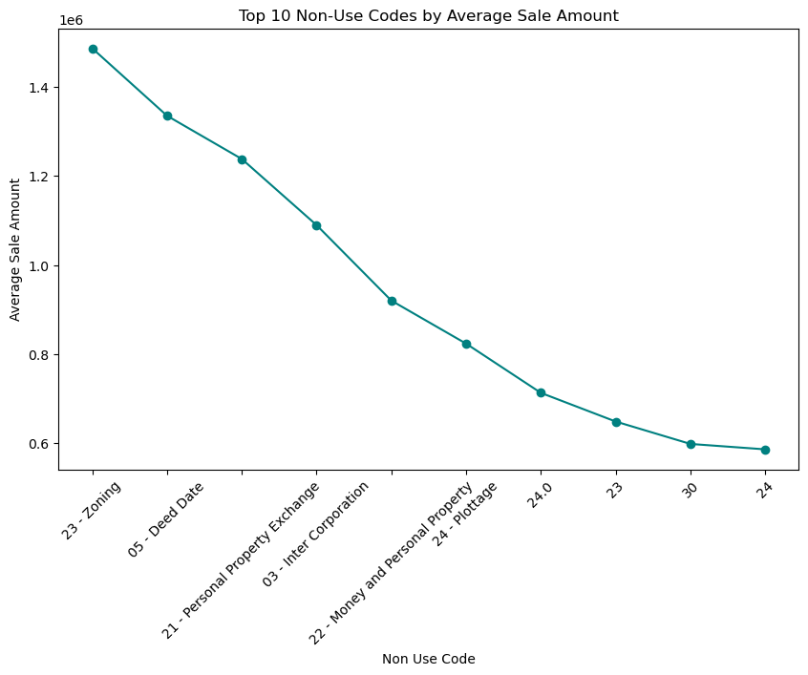
NON-USE CODES
The top non-use codes by sale amount include Zoning, Deed Date, Personal Property Exchange, Inter corporation, etc.
For assessed values, the top non codes include Part Interest, Easement, Deed Date, Inter Corporation, etc.
There were also a lot of numerical codes and alphanumerical codes applied too.
Non-Use Codes in real estate are numerical or alphanumeric identifiers used to categorize properties based on their current usage or status.
Notes:
They are typically assigned by local governments or regulatory agencies and are often part of property assessment and taxation systems.
Non Use Codes also indicate specific conditions or circumstances related to a property's use or status that may affect its valuation or tax treatment.
The exact meaning and classification of Non Use Codes can vary between different jurisdictions.
Non Use Codes play a crucial role in property assessment, taxation, and regulatory compliance.
They help authorities classify and manage properties more effectively, ensure equitable taxation, and identify properties that may require special attention or intervention.

Slide 11
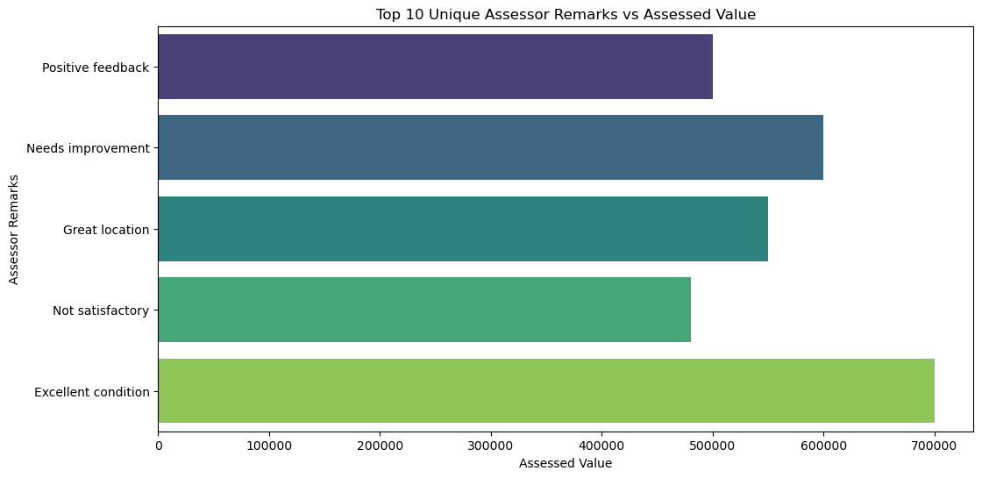

ASSESSOR AND OPM REMARKS
When the remarks were compared against Sale Value and Assessed Amount, it was observed that:
the 'Excellent Condition' remarks sold the highest, followed by
the 'Needs Improvements' remarks, then,
the 'Great Location', and
the 'Positive Feedback' remarks,
the 'Not Satisfactory' remarks sold the least.

Slide 12
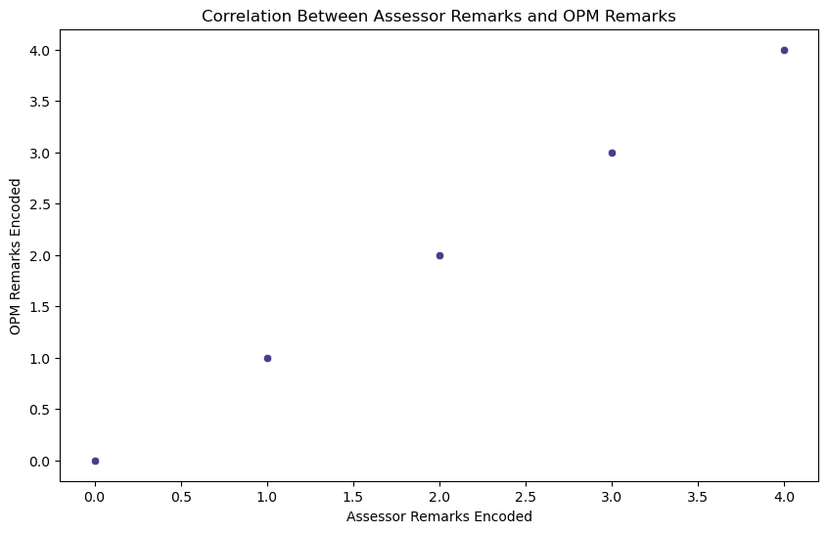
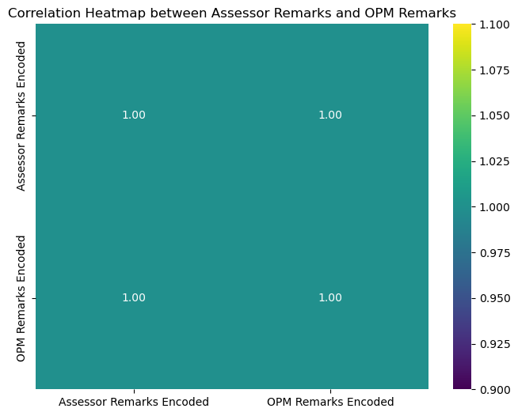
ASSESSOR AND OPM REMARKS
Also, there is perfect correlation between the Assessor Remarks and the OPM Remarks.

Slide 13
RECOMMENDATIONS
Firstly, giving real estate professionals access to comprehensive and up-to-date data, including market trends, market research reports, real-time property data, property transactions, and comparable sales, is crucial for informed decision-making.
Investing in data analytics tools and technology can help stakeholders analyze and interpret data effectively, enabling them to identify market trends, assess property values accurately, and make sound investment decisions based on current market conditions and future projections.
Additionally, fostering collaboration and knowledge-sharing among stakeholders, including real estate agents, appraisers, lenders, and policymakers, can enhance collective expertise and promote best practices in property valuation.
Moreover, promoting transparency and accountability in the assessment process, along with adherence to professional standards and ethical guidelines, is essential for building trust and confidence among stakeholders.
Finally, ongoing education and training programs tailored to the needs of different stakeholders(real estate professionals, appraisers, and assessors) can enhance their skills, knowledge, and competency in property valuation, decision-making processes and achieve greater accuracy in property assessments, ultimately driving better outcomes for all parties involved.

Slide 14

THANK YOU

